Slide 1
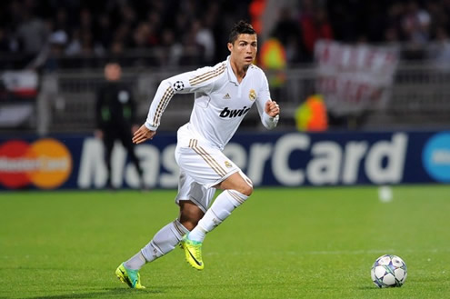
“Read the Game”
Closest Opponent:
7 m & behind
Chance of a Goal:
Very High
Distance to Goal:
32m
Player Speed: 12 kph
Ball Speed: 2 kph
by Sermetcan Baysal
CS 543 – Intelligent Data Analysis
Project Presentation

Slide 2
The Problem
“The thinking in soccer is outdated, backward and tradition-based. It needs a fresh look based on data.”
Simon Kuper,
Author, Soccernomics
Understanding of soccer based on conventional wisdom and experience
Rich analytics of sports has not been well exploited
Sports insight not further than raw and high level statistics
Gear with right data analysis tools and techniques

Slide 3
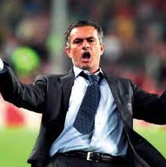
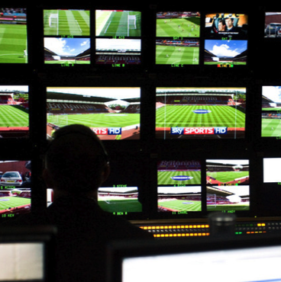
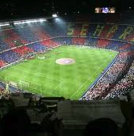
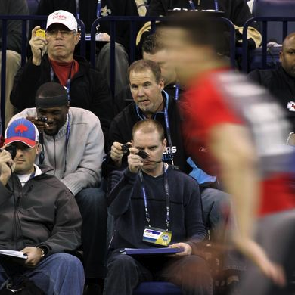
Change Understanding of the Game
Wealth of information at their disposals for decision making
Coaches
Broadcasters
Fans
Scouts
More fulfilling experience and deeper grasp of the game

Slide 4
Terim talking about Statistics

Slide 5
The Dataset
MCFC event dataset
Collected by OptaPro
Analytics provider company
Collected manually
On the ball events for every Premier League player in every match in the entire 2011-12 season
10368 rows
210 columns
Provided upon request as a part of research competition

Slide 6
Advantages/Disadvantages
No missing values +
Almost no errors +
All numeric data --
Classification, Association, Rule Learning cannot be utilized
Clustering, Correlation and Regression
Hard to get something ‘actionable’ --
Provided upon request as a part of research competition

Slide 7
List of events
Blocked shots
Goal/Own Goal
Recovery
Shots on/off target
Headed goals
Foul won
Forward passes
Ground duels
Shooting accuracy
Big chances
Corners
Aerial duels
Assists
Key Passes
Successful passes
Interception
Passes
Touches
Time-played
Crosses
Dribbles
Last-man tackle
Blocks
Flick-ons
Successful dribbles
Offsides
Red cards
Clearances
Tackles
Challenges lost
Goals inside box
Clear off line
Penalties

Slide 8
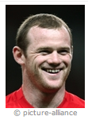
An Example: Player at a match
Opponent | Chelsea (Away) on 02-05-2012
Goals | 2
Shots on/off Target | 5 / 1
Passes Succ/Unsucc | 37 / 17
Duels won/lost | 6 / 6
Ground duels won/lost | 3 / 2
Touches | 72
Big chances | 2

Slide 9
More examples…
Player stats for a specific match
Player stats for the whole season
Team stats for a specific match
Team stats for the whole season

Slide 10
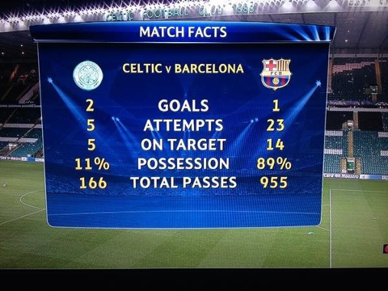
Can you predict the winner?

Slide 11
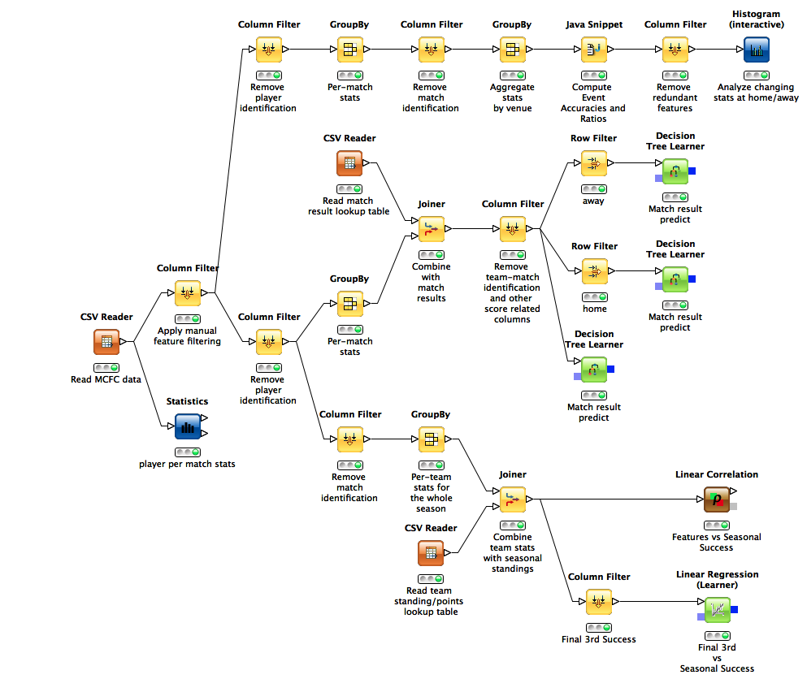
An attempt to predict the ‘win’
Notes:
Expand to virtually any team sport, and geography
Carry out analyses that will change the way we see and study tactics & performance
Take the delivery capability to consumers and engage with sports fans

Slide 12
Correlation with Seasonal Success
Points – Successful Passes in the Final Third: 0.89
Points – Assists: 0.89
Points – Big Chances: 0.81
Points – Goals : 0.90

Slide 13
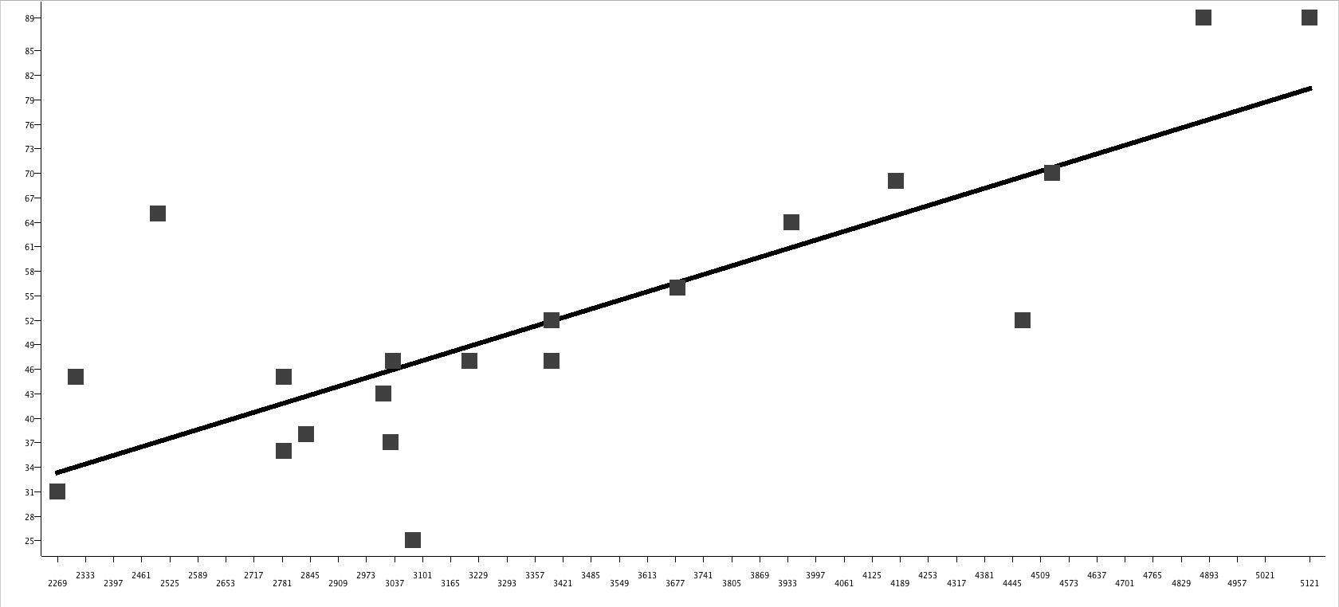
Successful Final 3rd Passing
Points gathered in the season
Successful Passes in the Final 3rd

Slide 14
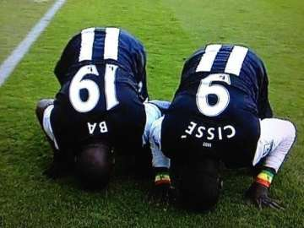
The Outliers
Liverpool
Poor shooting accuracy 40%
308 is the number of shots off target (Highest in EPL!)
Poor crossing accuracy 21%
865 is the number of unsuccessful crosses (Highest in EPL!)
Action: Should sign a striker and a winger
Newcastle
Less shots on goal (154) than Liverpool (207)
Higher chance conversion accuracy (33%) than Liverpool (20%)
Ba and Cisse scored a total of 29 goals

Slide 15
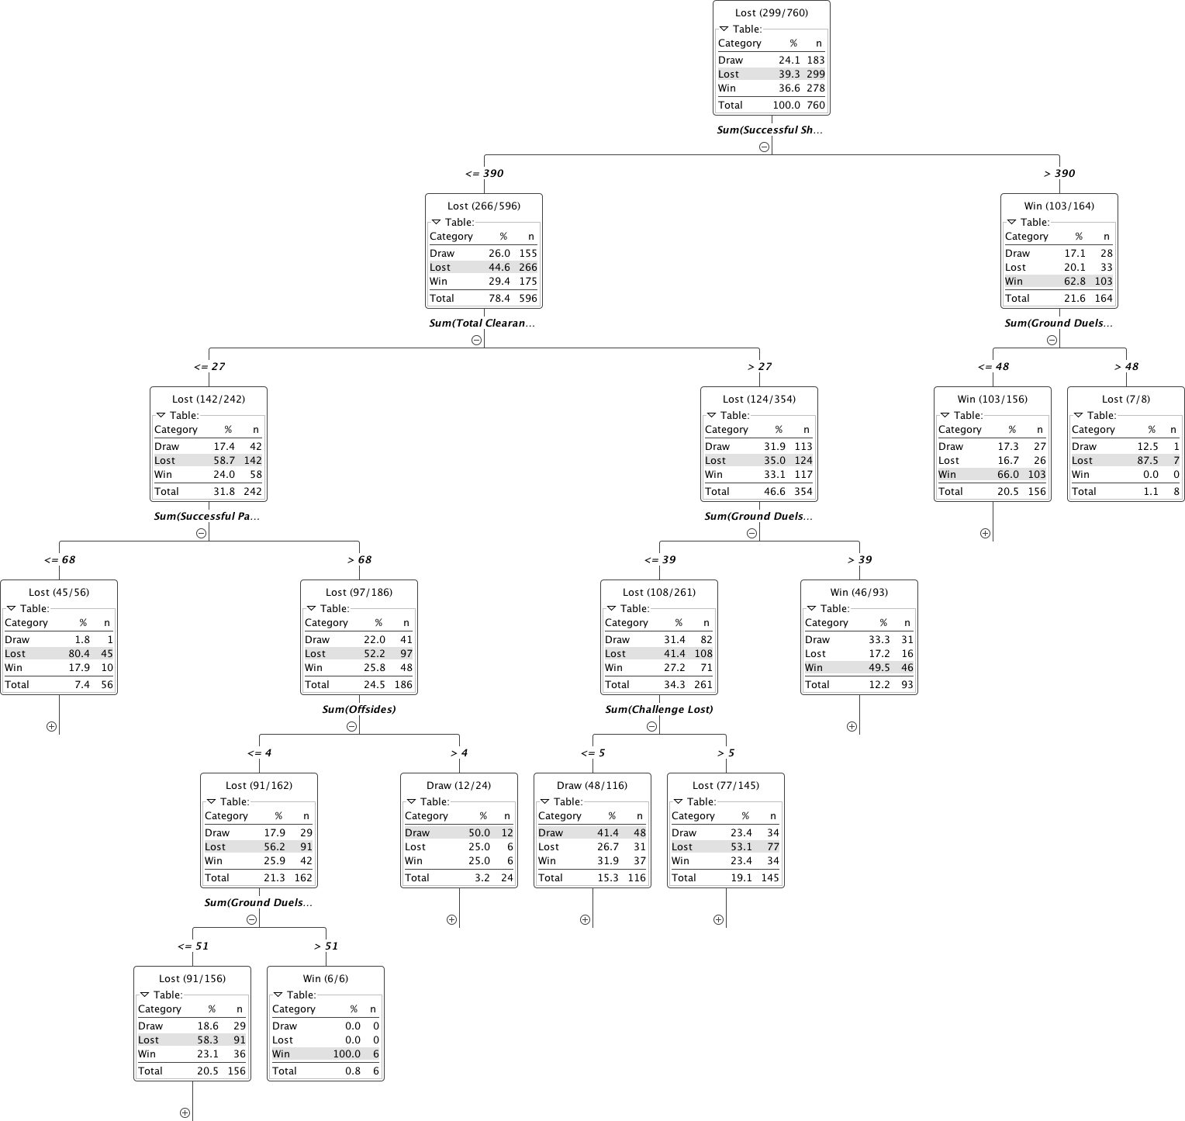
Last struggles… Tree for the win
Successful short passes are important (of course!)
Ground duels won/lost is a decider

Slide 16
Lessons Learned
Successful passes in the final third is a ‘must’ for victory
Liverpool should immediately sign a winger and a striker
Enquiry to Newcastle: “Is Ba & Cisse for sale?”
Short passing and ground duels are important
Is this it? Really?

Slide 17
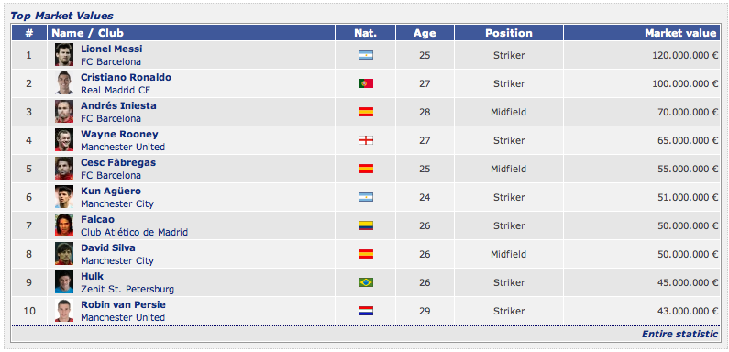
The Problem (Revised)
Value vs Performance…
Finding the right player at right price
Inaccuracies in valuing the players
Ilhan Cavcav effect on the market

Slide 18
The Moneyball

Slide 19
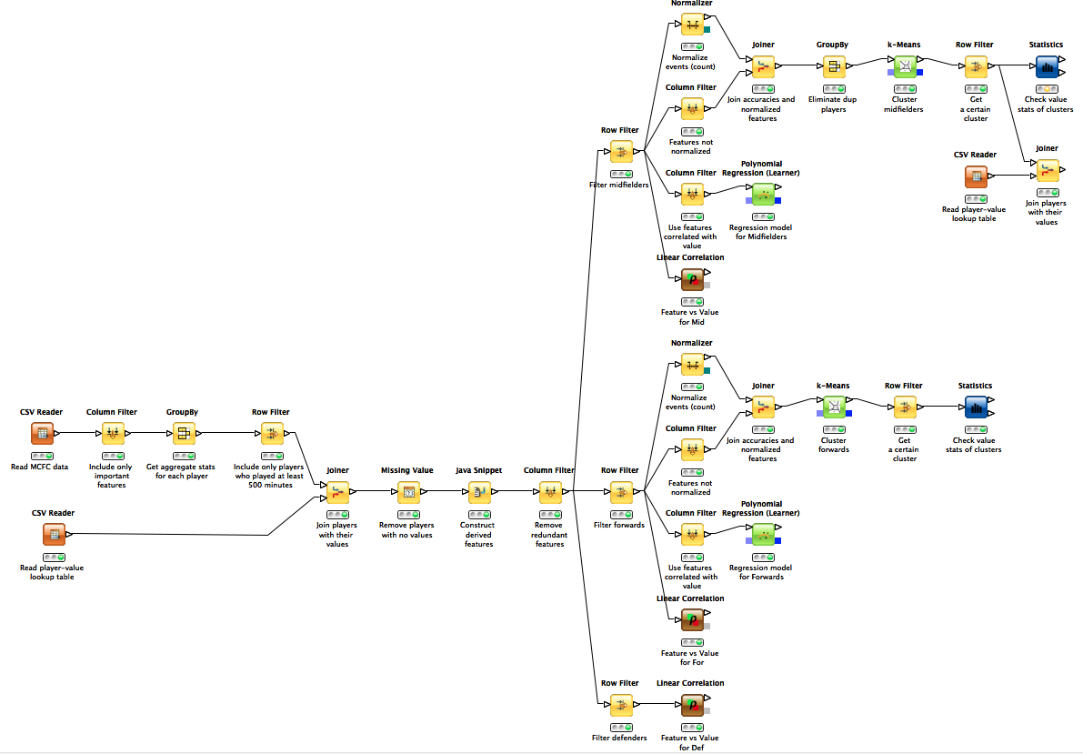
Moneyball for Soccer

Slide 20
Moneyball for Soccer
DEF
MID
FOR
Defenders no strong correlation on any feature (> 0.50)
Midfielders
Chances created: 0.58
Passes in the final 3rd: 0.58
Forwards
Goals: 0.66
Shots: 0.66

Slide 21
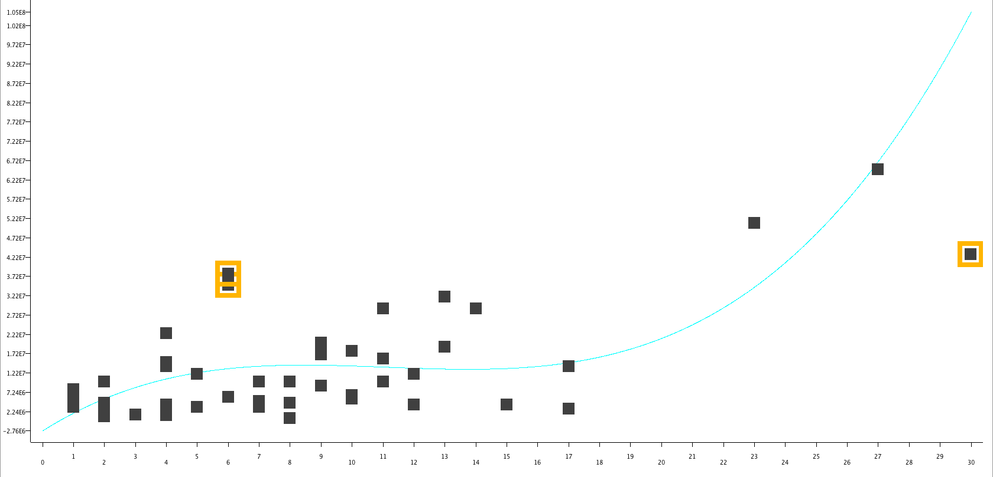
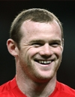
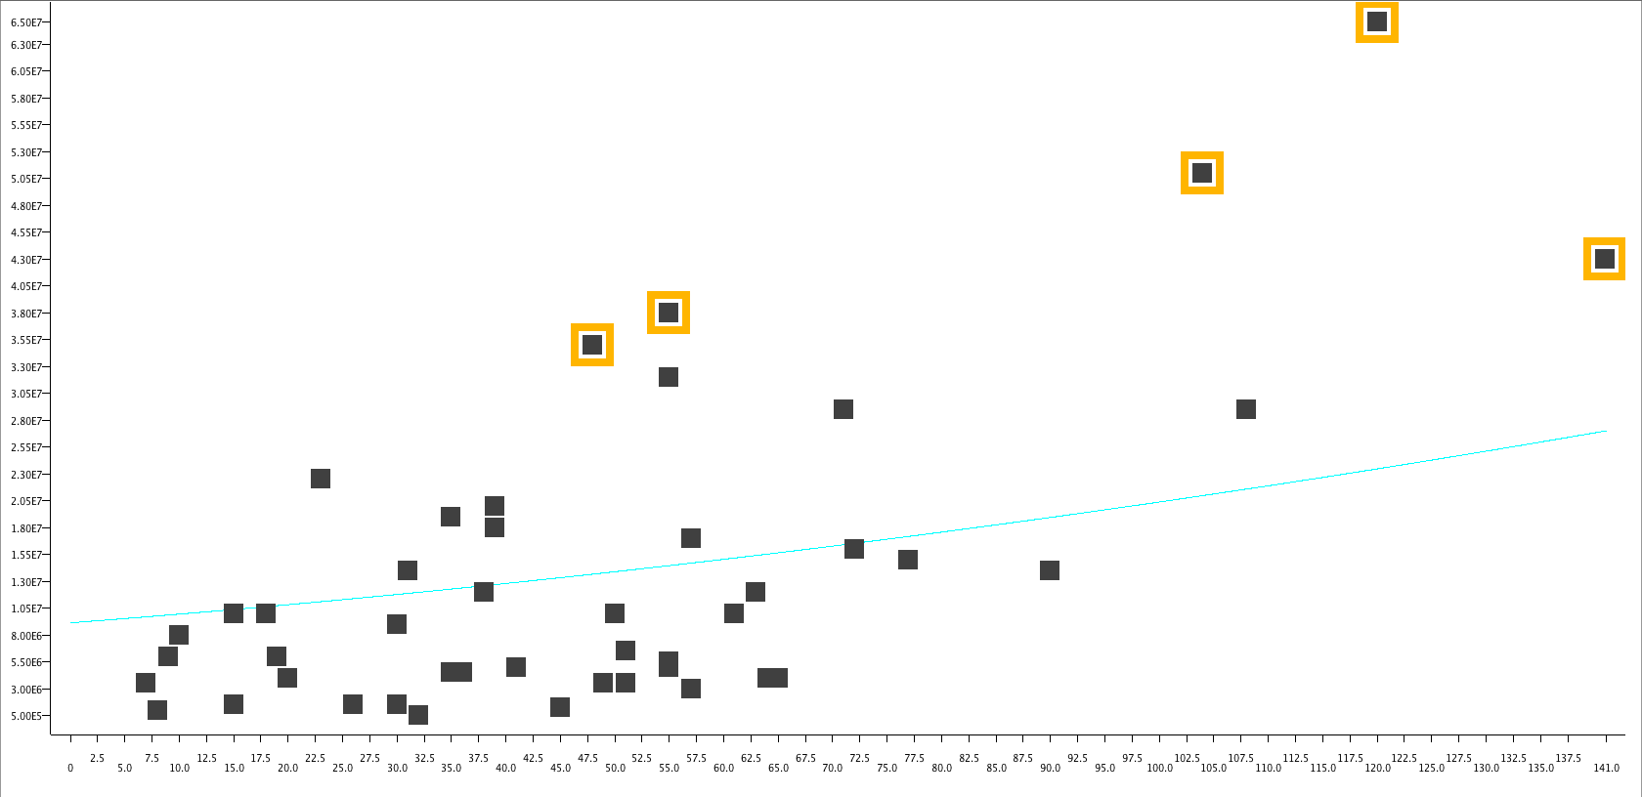
Regression of Forwards
Aguero
Man. City
€51m
23 goals
104 shots
Player Value
Juan Mata
Chelsea
€38m
6 goals
55 shots
Number of Goals
Robin v. Persie
Arsenal
€43m
30 goals
141 shots
Fernando Torres
Chelsea
€35m
6 goals
48 shots
Player Value
Adebayor
Tottenham
€14m
17 goals
78 shots
Rooney
Man. Utd
€65m
27 goals
120 shots
Number of Shots

Slide 22
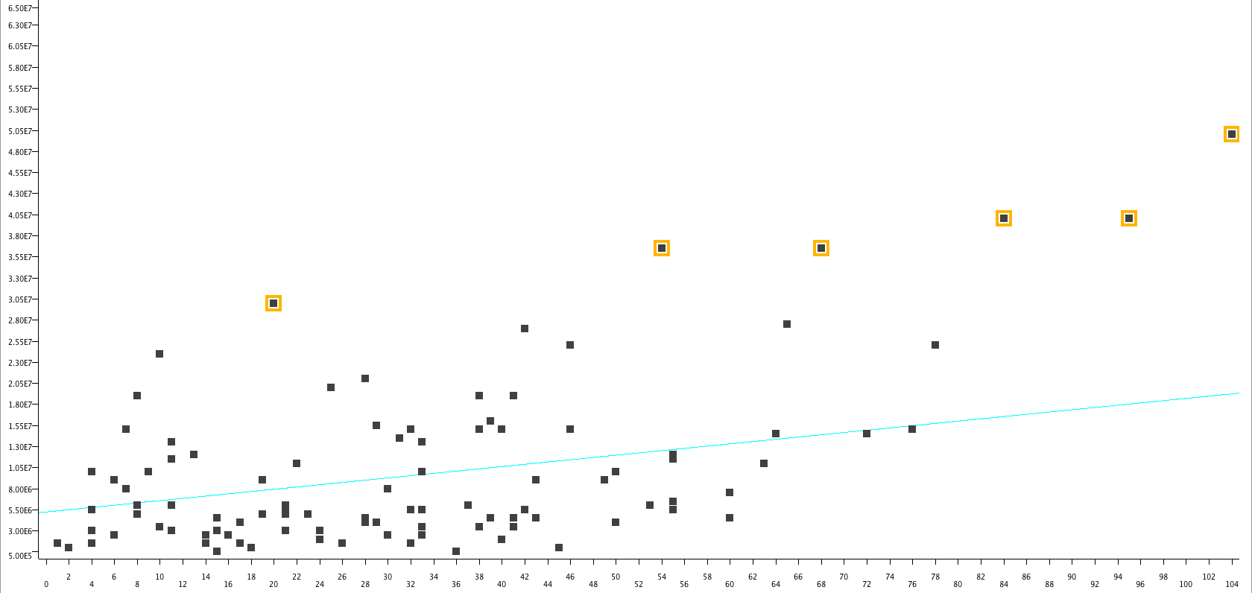
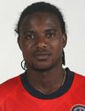
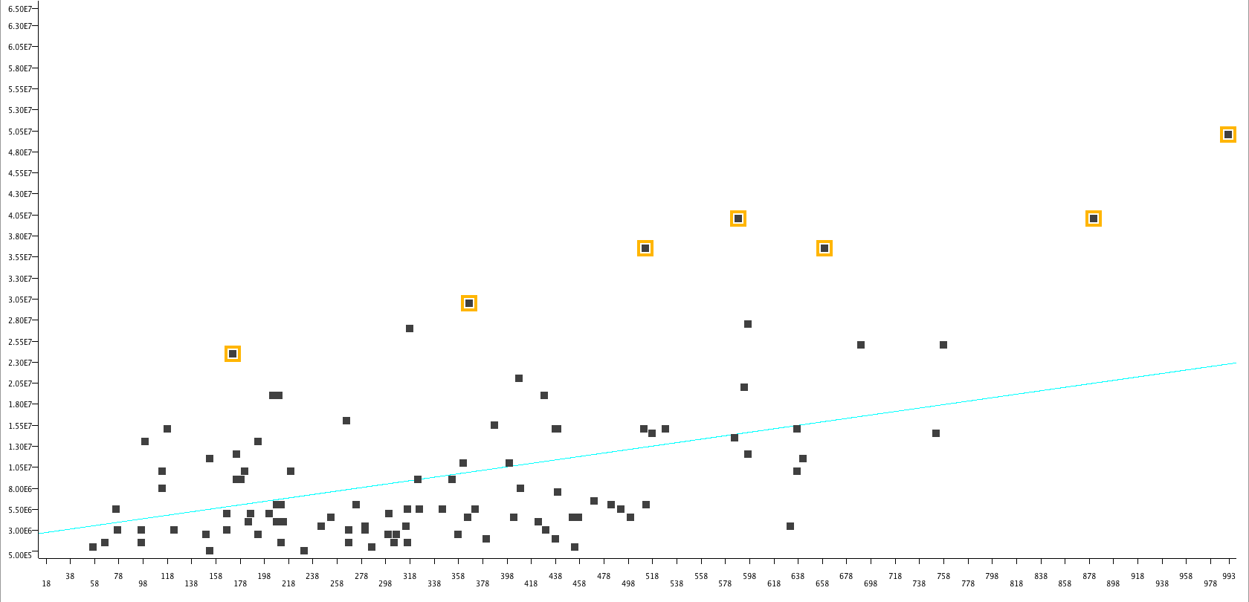
Regression of Midfielders
D. Silva
Yaya T
Nani
Bale
Player Value
Ramires
Modric
S. Sessègnon
Sunderland
€14.5m
72 chances created
518 passes in f 3rd
Chances Created
D. Silva
Yaya T
Nani
Bale
Ramires
Modric
v. der Vaart
Tottenham
€15m
76 chances created
637 passes in f 3rd
Player Value
A. Young
Passing in Final 3rd

Slide 23
Cluster Model for Midfielders
Cluster 0 (4)
€1m - €11.5m
€5.8m ± €4.6m
Cluster 2 (11)
€4m - €50m
€19m ± €15.8m
Cluster 7 (12)
€1m - €21m
€7.1m ± €6.8m
Cluster 5 (10)
€6m - €40m
€18m ± €12.2m
Cluster 6 (3)
€0.5m - €15m
€6m ± €7.8m
Cluster 4 (4)
€3m - €14m
€8.5m ± €4.9m
Cluster 3 (13)
€1.5m - €27.5m
€11m ± €9.2m
Cluster 1 (8)
€2m - €30.5m
€10.3m ± €9.3m
Cluster 9 (26)
€0.5m - €24m
€6.8m ± €6m
Cluster 8 (14)
€1.5m - €19m
€4.6m ± €5.2m

Slide 24
Use the Clusters for Scouting
Liverpool needed a good dribbler and crosser
Cluster with most number of “Dribbles”
Cluster with most accurate “Dribbles”
Cluster with most number of “Crosses”
Cluster with most accurate “Crosses”
We found that ground duels were important
Cluster with most number of “Ground Duels”
Cluster with most accurate “Ground Duels”
Cluster with most number of “Tackles”
Cluster with most accurate “Tackles”
Cluster with interceptions
Cluster 2 (11)
€4m - €50m
€19m ± €15.8m
Wingers
Attacking Mid.
Cluster 5 (10)
€6m - €40m
€18m ± €12.2m
Strong
Defensive Mid.

Slide 25
Decision Support for Scouts
Cluster 2 of Wingers & Attacking Midfielders
Cluster 5 of Strong Defensive Midfielders

Slide 26
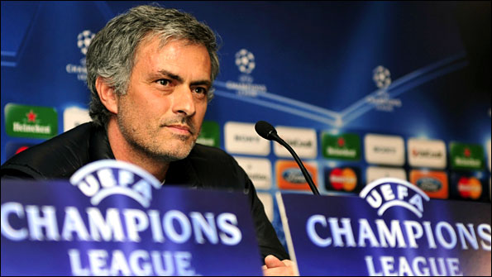
Q&A at Press Conference

